Slide 1
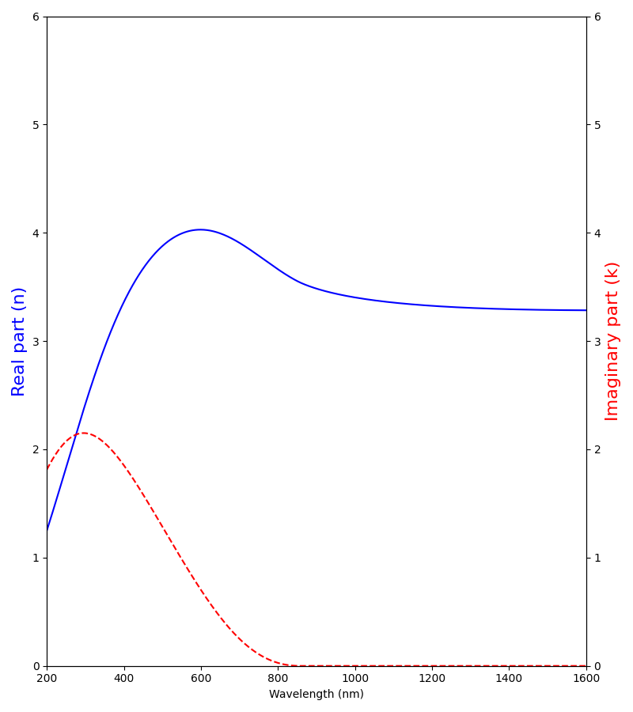
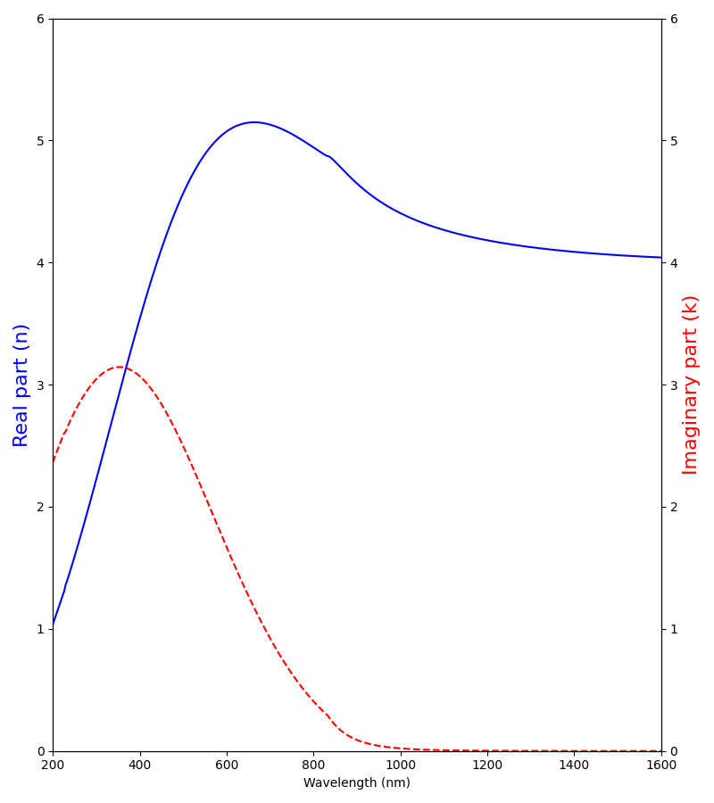
(a)
(b)

Slide 2
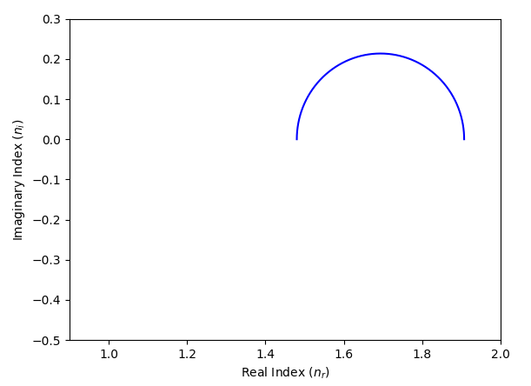
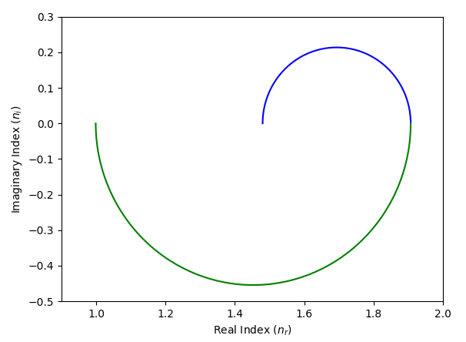
(a)
(b)
n_{r}=n_{a}=1.0
n_{s}=1.5

Slide 3
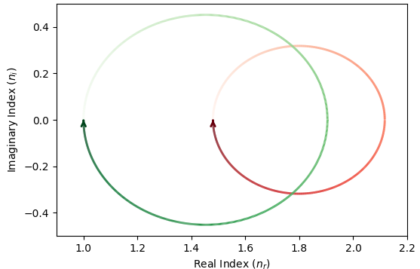

Slide 4
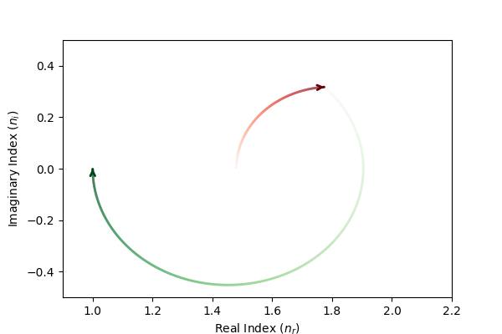
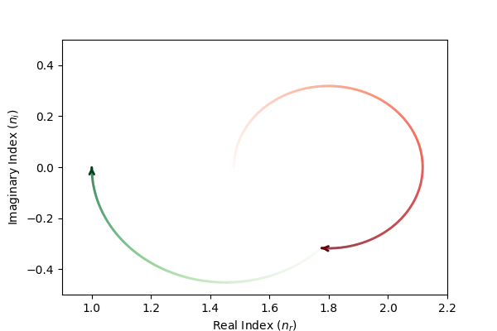
(a)
(b)
θ = 0.53 QWOT
θ = 1.18 QWOT
θ = 0.82 QWOT
θ = 1.47 QWOT

Slide 5
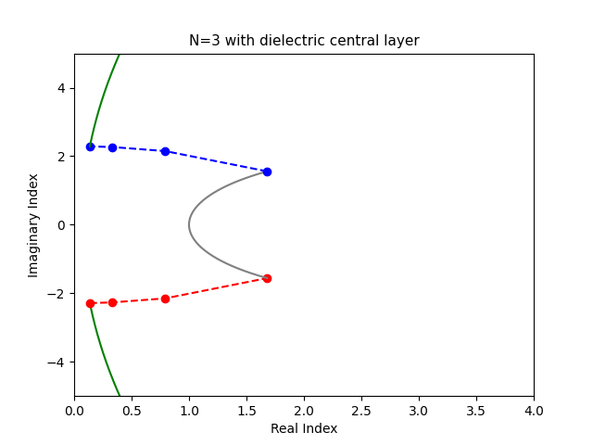
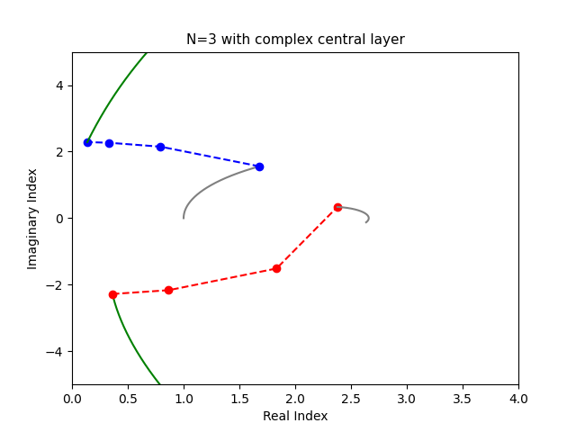
(a)
(b)

Slide 6
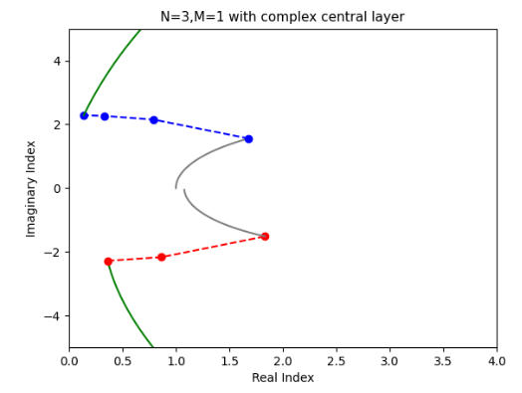

Slide 7

Compensator layer

Slide 8
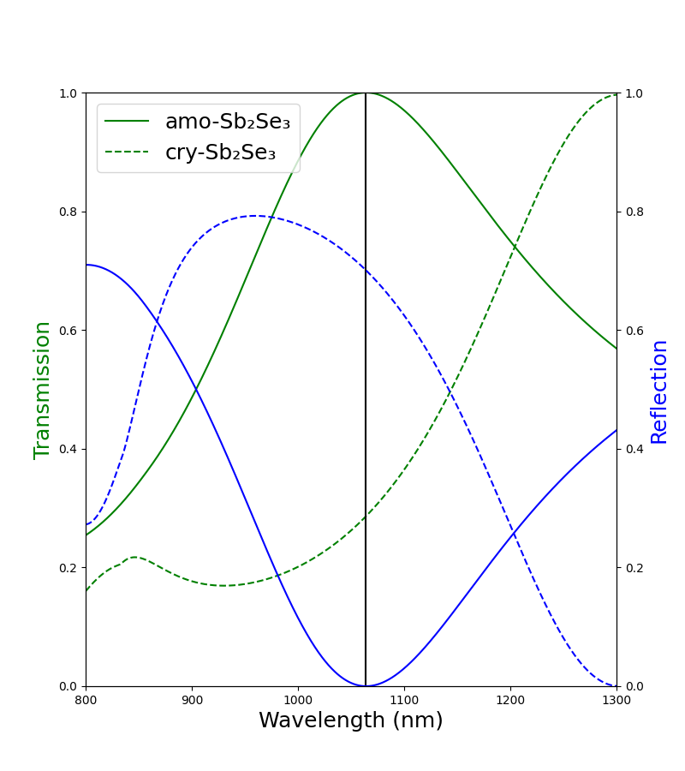
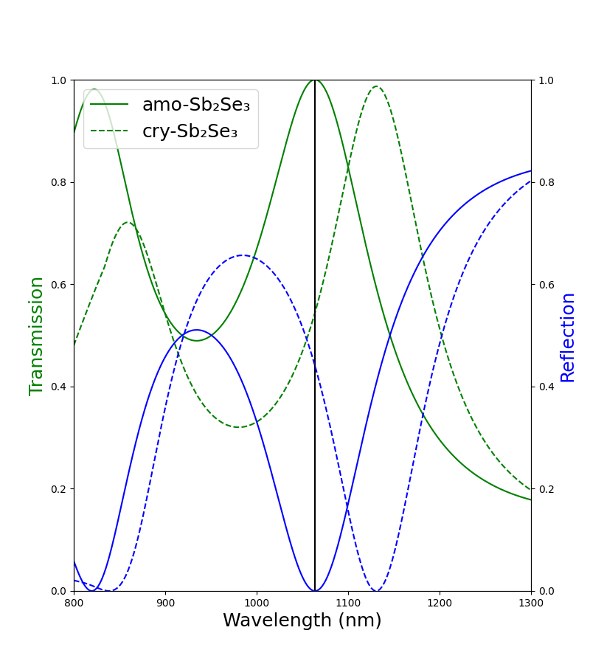
(a)
(b)

Slide 9
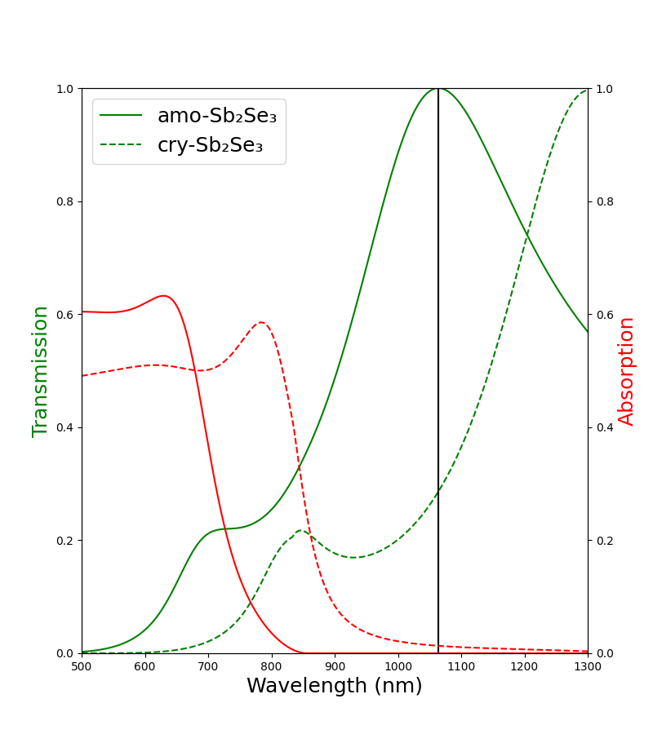
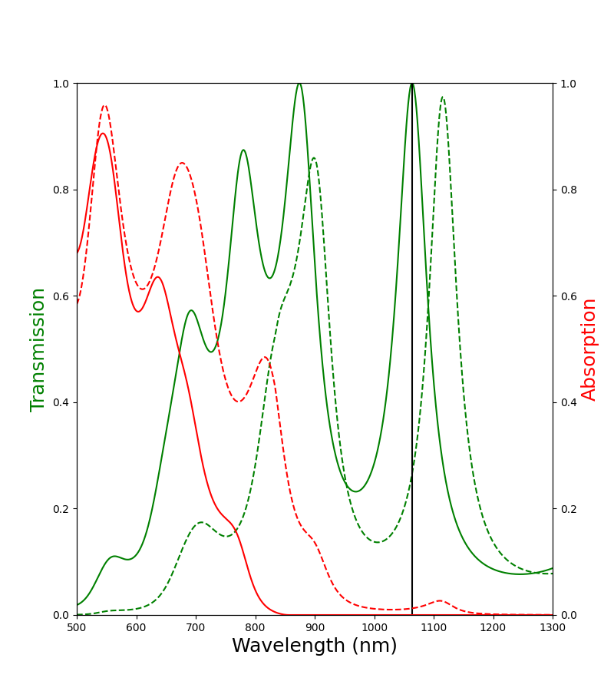
(a)
(b)

Slide 10
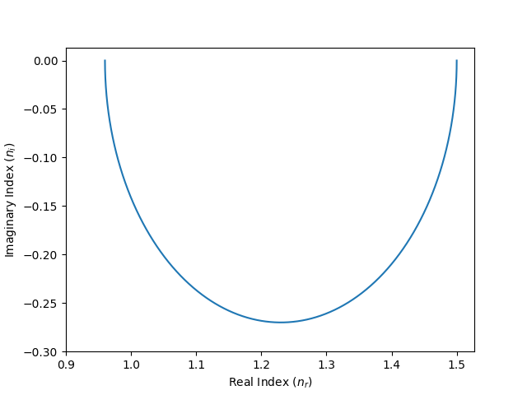
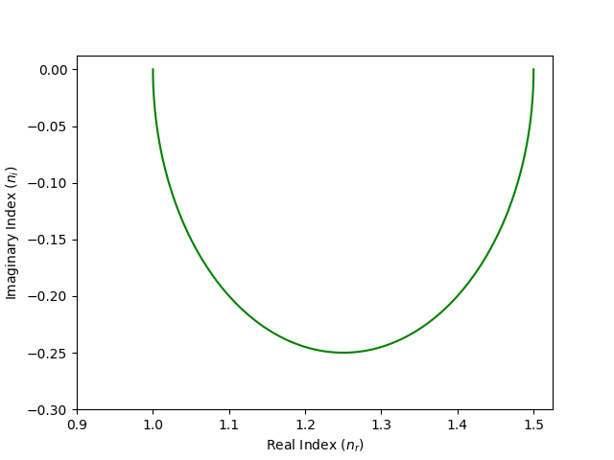
θ = π/2
n_{r} = 0.96
θ = 0
n_{r} = 1.5
θ = π/2
n_{r} = 1.00
θ = 0
n_{r} = 1.5
(a) (b)

